Slide 1



System
Student Management
PRESENTING BY:
RITIK KADOLE
SCHOLAR NO:
202120130
DEPARTMENT
INSTITUTE
SUPERVISOR:
MANIT (BHOPAL)
Dr. Amit Bhagat
Keeping is EASY now !!!
COMPUTATIONAL AND INTEGRATED SCIENCE (BIO INFORMATICS) & COMPUTER APPLICATION

Slide 2

Purpose of “Student Management System”
“As the name depicts this is a Record keeper for student Details and keep tracking of student progress.”

Slide 3



Technologies Used in this Project
Tkinter
Python
MySQL
This will be used to create simple GUI Interface
Python will be used as a main language to program.
These are some technologies more technologies may be added later…
MySQL is used as main database.
IDE
Any Integrated Development Environment can be used to create this project and my preference is VS-Code.

Slide 4


Scope of the Project
Library Record keeper.
project Record keeper.
Product Sell \ Purchase (trading) Record keeper.
Any type of record keeper.
We can Change this Project’s attributes and change this project into any type of record keeper like…

Slide 5
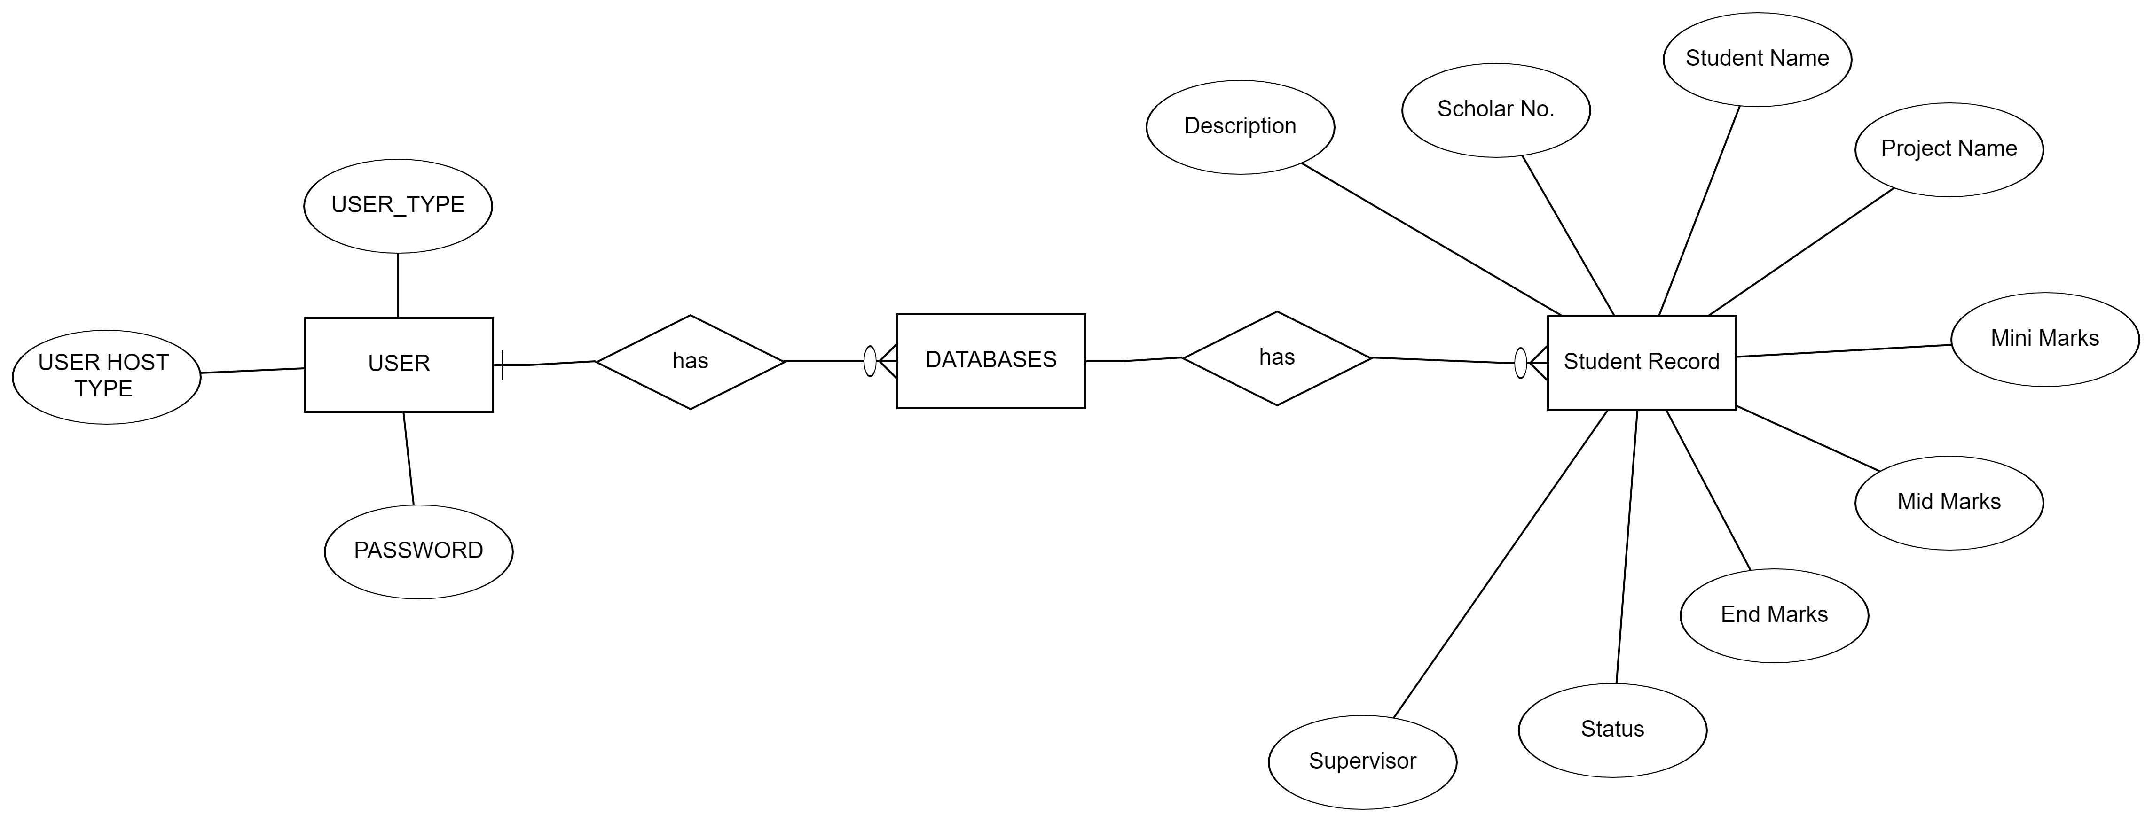
ER Diagram of the Project

Slide 6
* MODULES
1. ADD STUDENT RECORD 2. SEARCH STUDENT 3. DELETE STUDENT RECORD 4. UPDATE STUDENT RECORD 5. SHOW ALL STUDENT 6. EXPORT DATA 7. EXIT

Slide 7

FIRST SCREEN LOOK
This is first look after you open the application

Slide 8
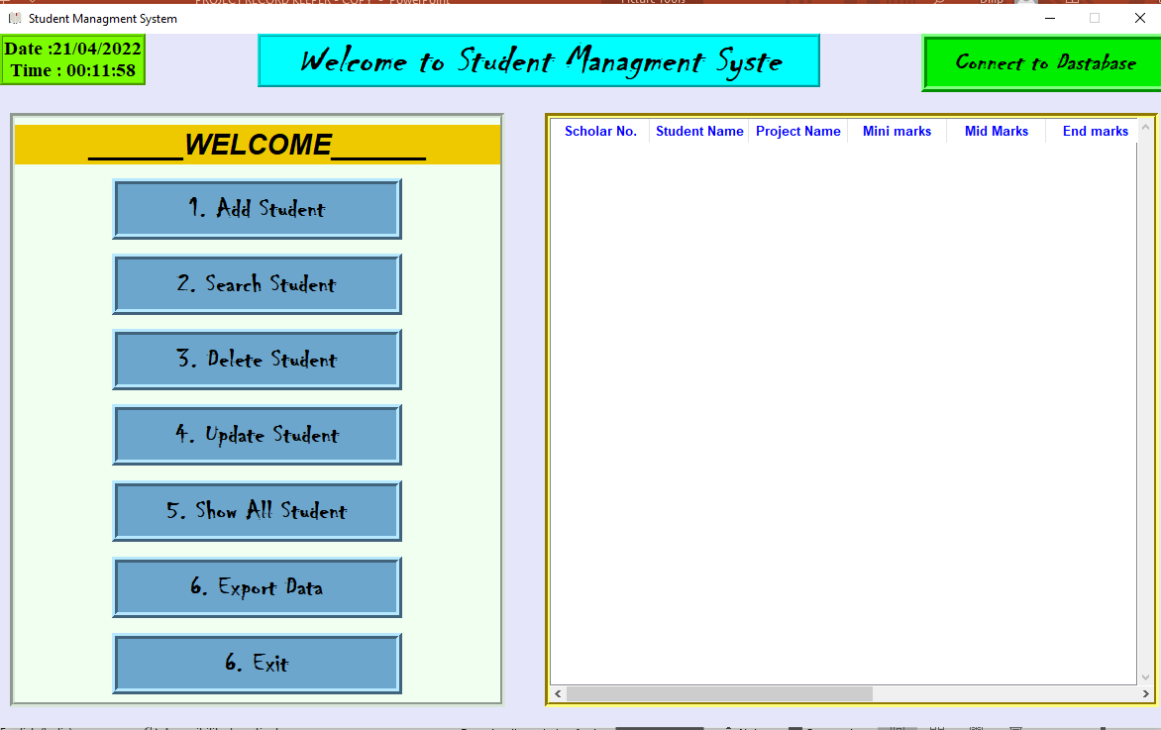
FIRST LOOK AFTER OPENING THE APPLICATION

Slide 9
Login Design
We can click on
“ Connect to Database ” button & enter details to login.

Slide 10
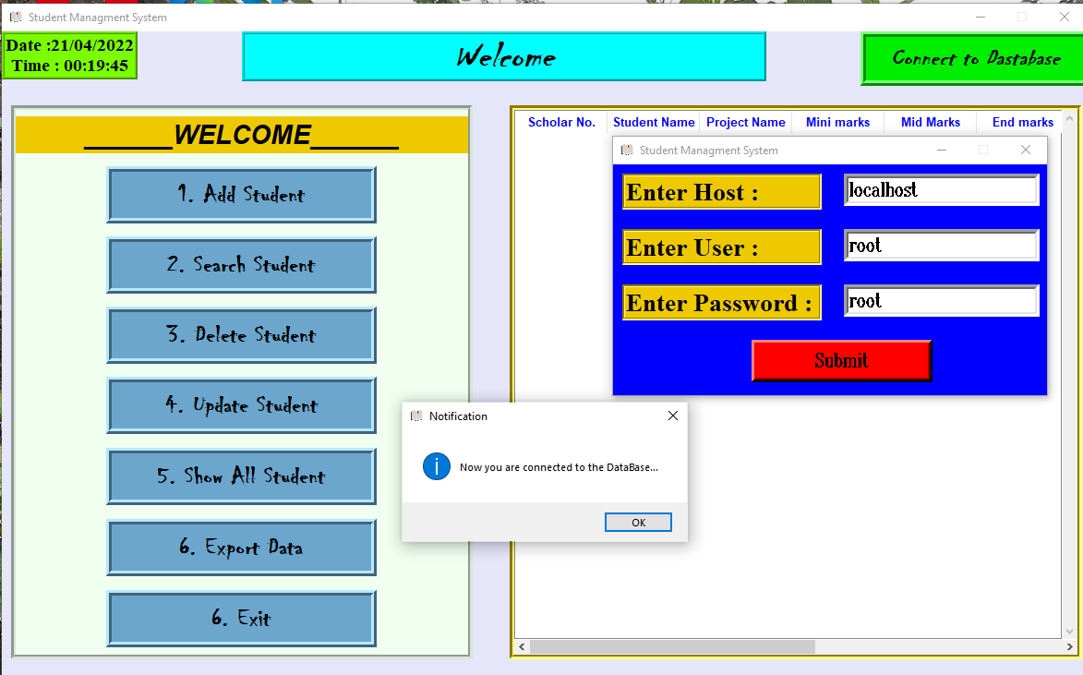
SCREEN DESIGN FOR LOGIN

Slide 11
01
Add New Student

Slide 12
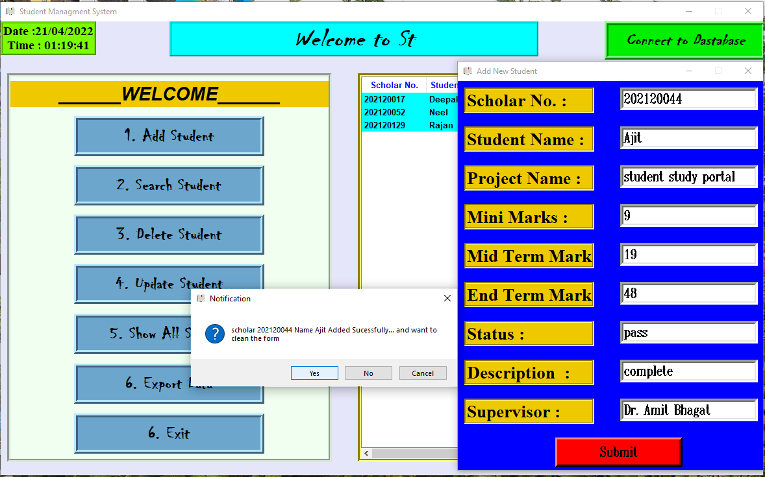
ADD FUNCTION DESIGN

Slide 13
02
Search Student

Slide 14
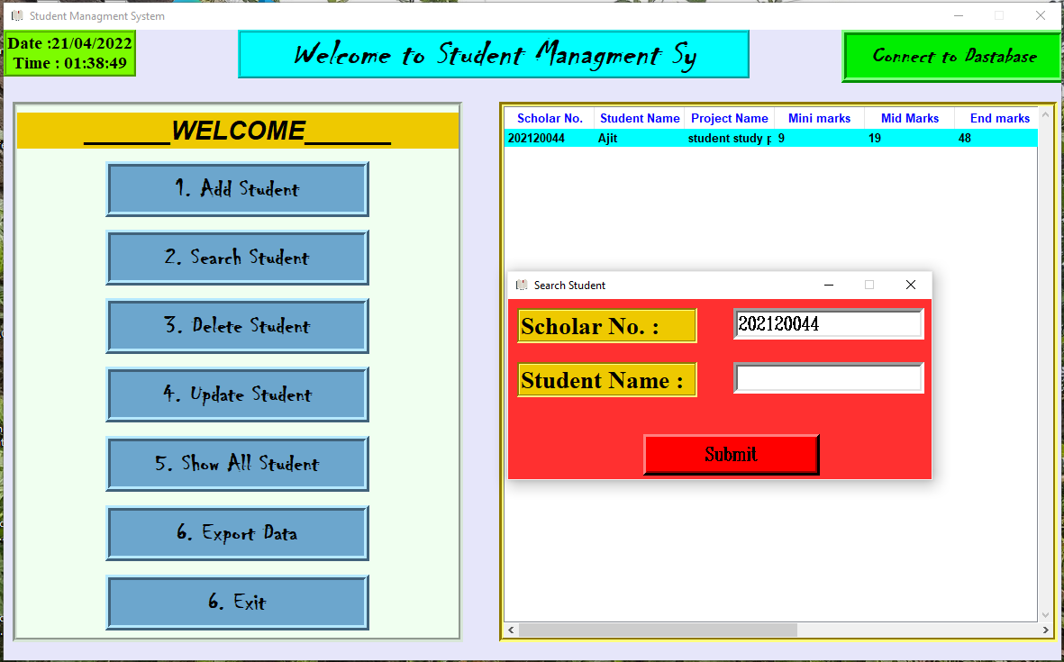
SEARCH FUNCTION DESIGN

Slide 15
03
Delete Student Record

Slide 16
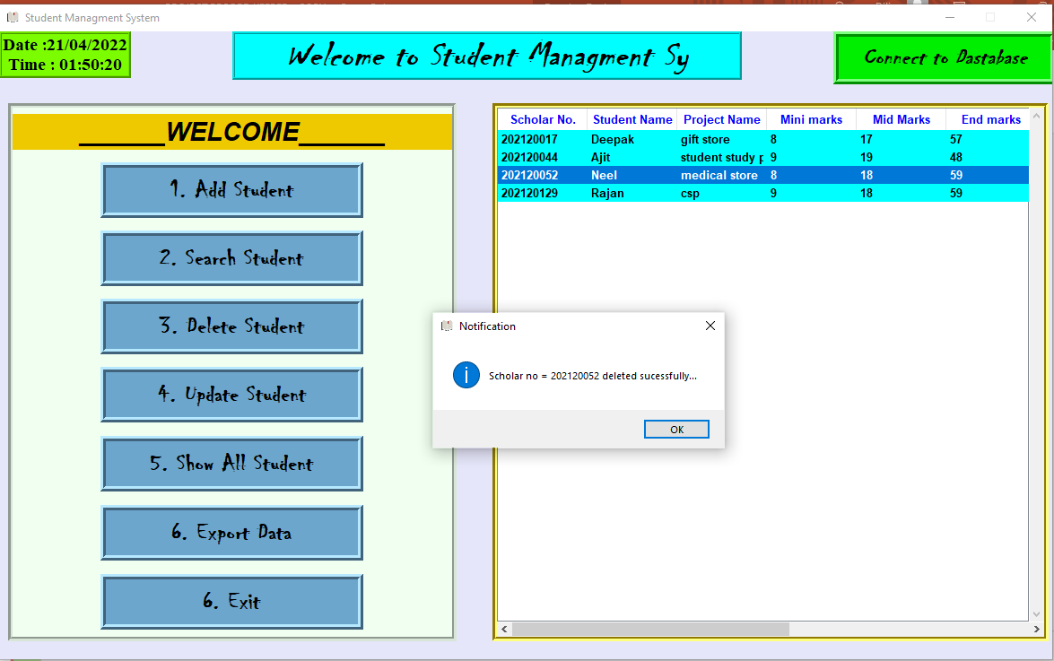
DELETE FUNCTION DESIGN

Slide 17
04
EXIT

Slide 18
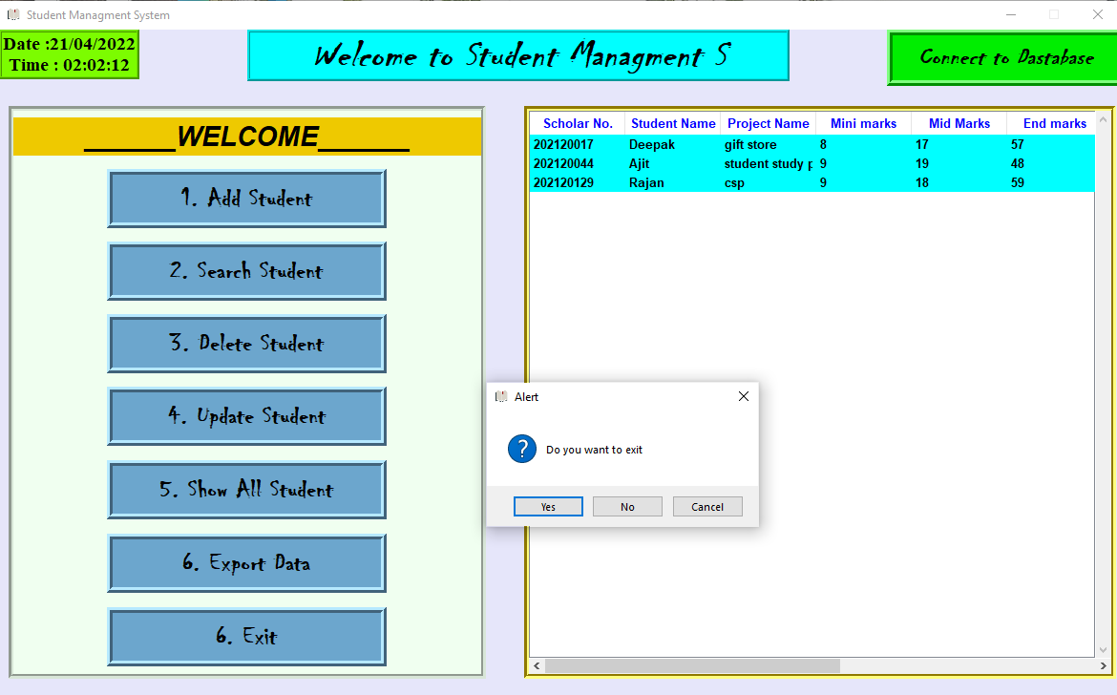
EXIT FUCNTION DESIGN

Slide 19

Thank You

